Slide 1






PYTEST
Presented by - Group 1

Slide 2




Table Of
1
Introduction
2
Overview
Contents
3
Motivation
4
Installation
5
Testing Techniques
6
Plugins
7
Conclusion

Slide 3




Introduction
Pytest is a well-liked open-source Python software testing framework . It enables programmers to create tests for their Python programs that are effective, scalable, and maintainable.
Pytest makes it simple to get started even for individuals who are new to testing with its straightforward and understandable API for developing tests.
Pytest was developed with the intention of making testing easier and more enjoyable for Python developers. .

Slide 4




Overview
The well-liked Python testing framework Pytest enables programmers to create
straightforward, scalable, and reliable tests. Numerous testing approaches, such as functional testing, unit testing, and integration testing are supported.
Pytest is superior to other testing frameworks like unittest in a number of ways. First off, Pytest provides a more streamlined and understandable syntax that makes writing and reading test code simpler.

Slide 5
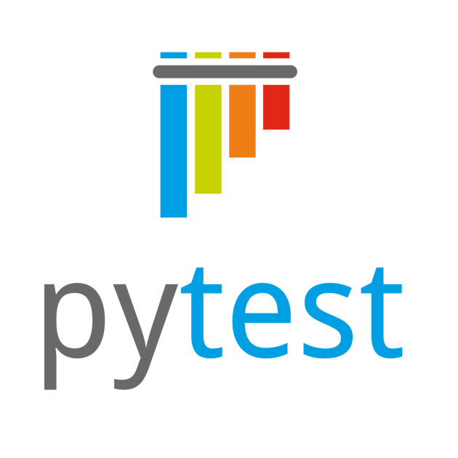
Overview
The official website for Pytest is https://docs.pytest.org/en/latest/.

Slide 6





Motivation
Some Features that motivated to use PyTest
More Simplicity Simple test execution
strong and adaptable test fixtures
a vast collection of assertion helpers Support of Plugins
Compatibility Community

Slide 7
Installation
Pytest is simple to install using either the conda package manager included
in the Anaconda installation or the pip package manager for Python.
pip install pytest

Slide 8
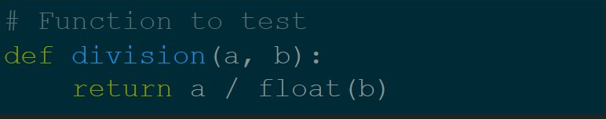
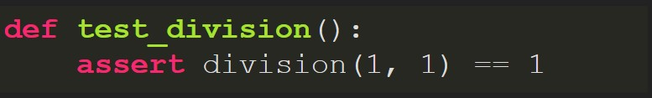
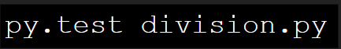
Write and run your first test
1. create a function with the test_ prefix
2. run tests

Slide 9
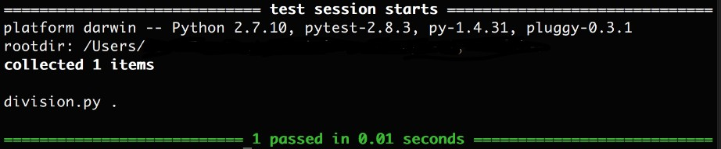
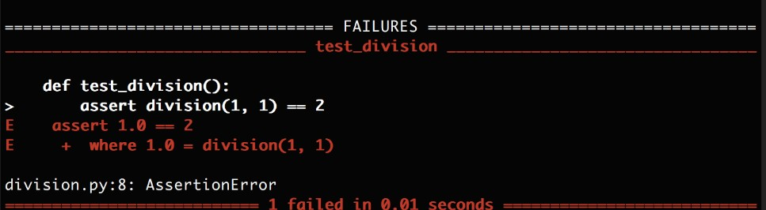
Test Results
Passing Test
Failing Test

Slide 10





Testing
01
02
03
04
Integration Testing
Functional Testing
Performance Testing
Unit Testing

Slide 11
Unit Testing
INTRODUCTION
Unit testing is a software testing technique, focuses on testing individual software application units or components separately from the rest of the system.
Each unit of code is tested separately during unit testing to make sure it operates as intended and complies with the requirements.

Slide 12
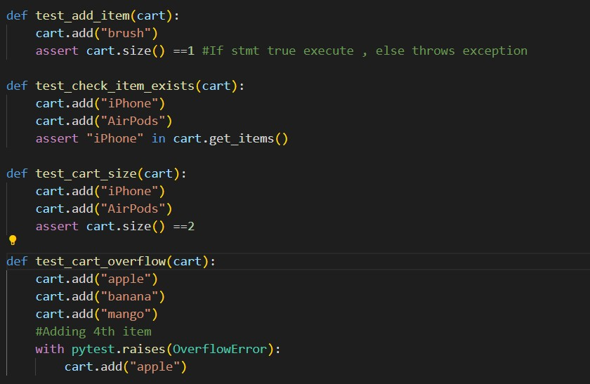
Unit Testing
Unit Test Script

Slide 13
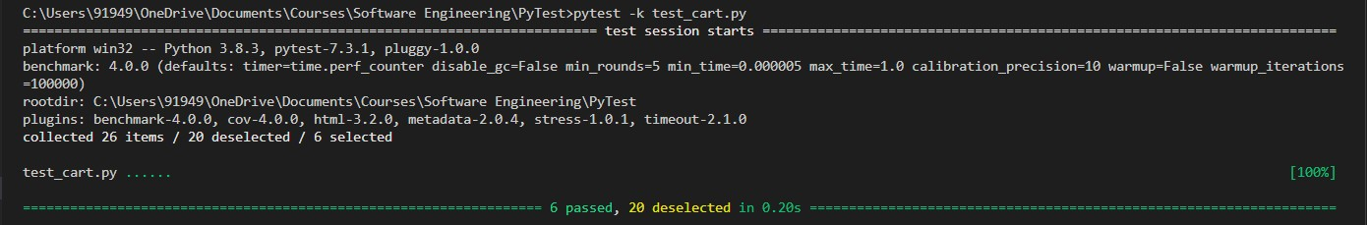
Unit Testing
Run unit test
Result

Slide 14
Testing
01
02
03
04
Integration Testing
Functional Testing
Performance Testing
Unit Testing

Slide 15
Integration Testing
INTRODUCTION
Software testing known as "integration testing" checks the interactions between various modules to make sure the system as a whole functions properly.
Instead than testing the underlying workings of each component individually, integration testing concentrates on verifying the interfaces and interactions between the components.

Slide 16
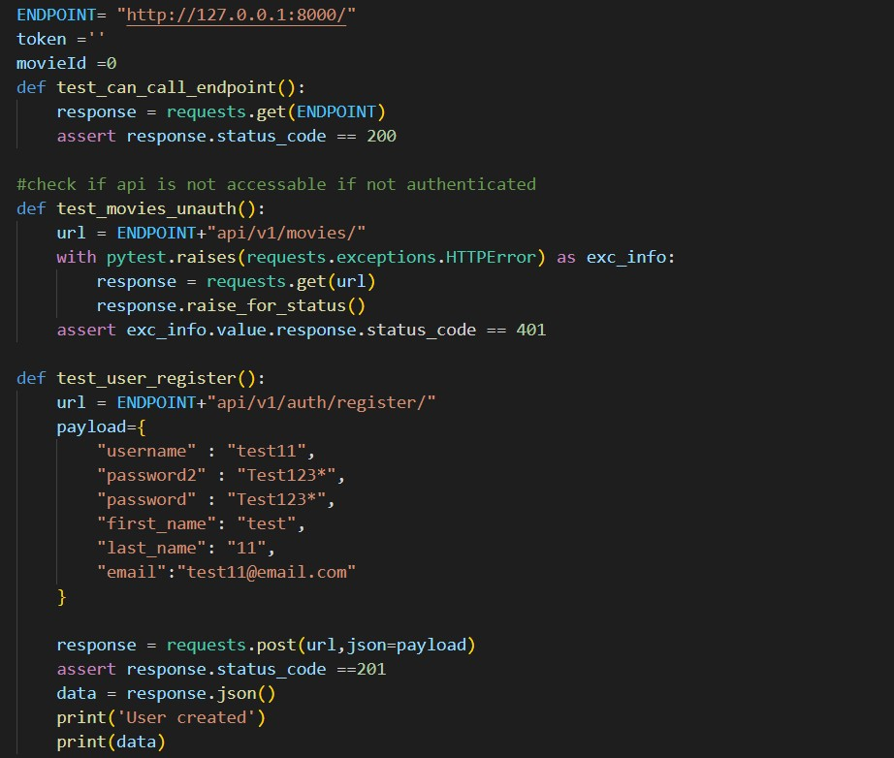
Integration Testing
Integration Test Script

Slide 17
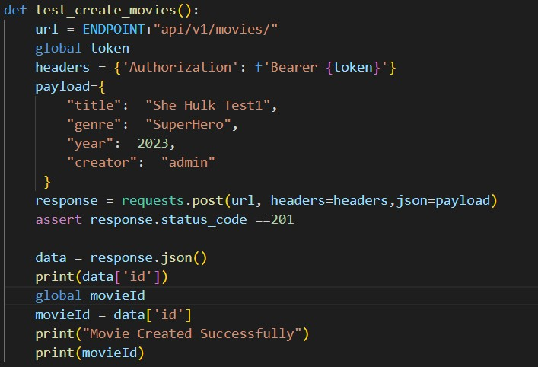
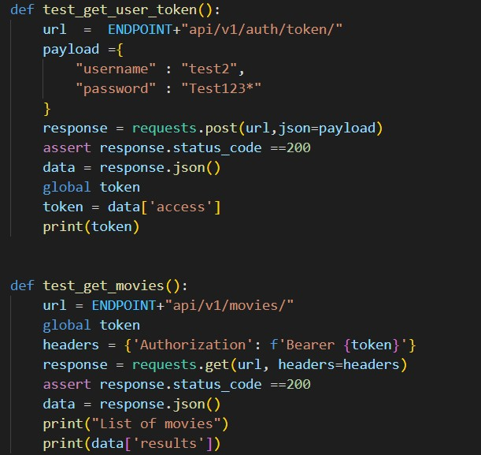
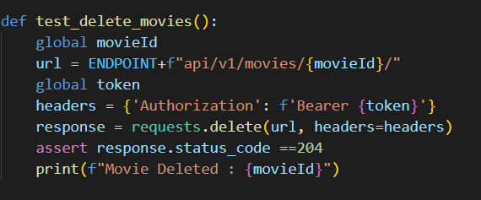
Integration Testing
Integration Test Script

Slide 18
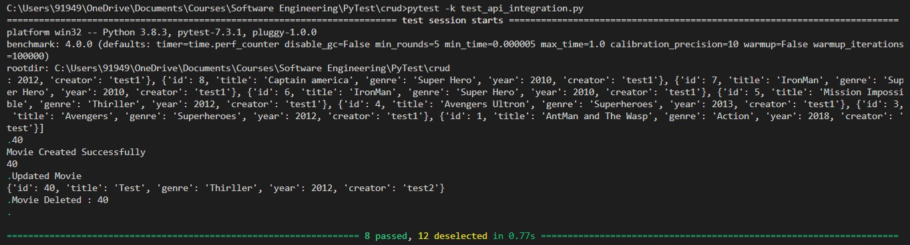
Integration Testing
Run integration test
Result

Slide 19
Testing
01
02
03
04
Integration Testing
Functional Testing
Performance Testing
Unit Testing

Slide 20



Functional Testing
INTRODUCTION
Functional testing is a sort of software testing, that assesses a software application's functionality, by comparing a software application's functionality to the functional requirements, specifications.
Functional testing focuses on examining how the application's features, functionalities, and behavior will appear to end-users and that it meets the business
and user requirements.

Slide 21
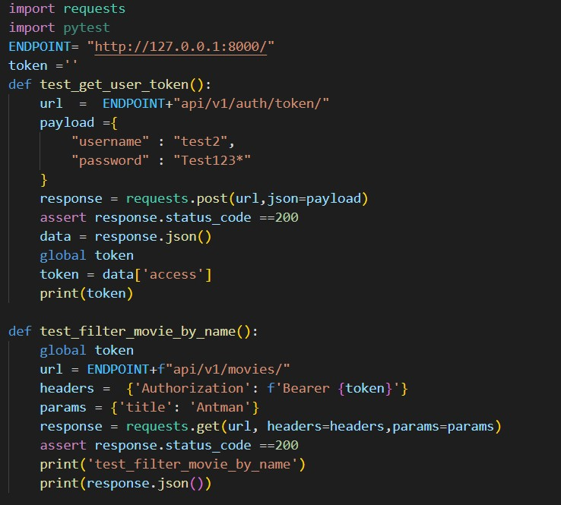
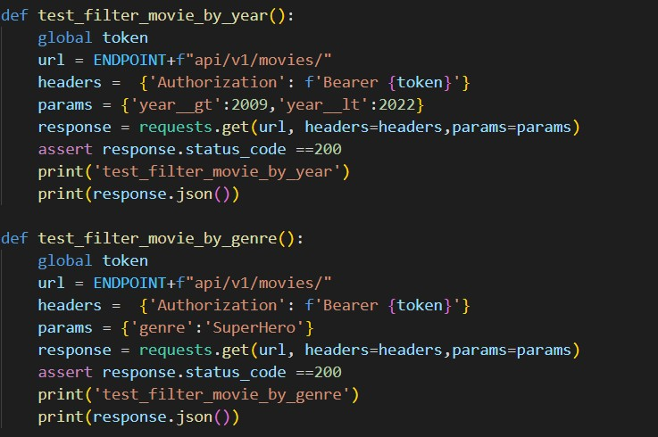
Functional Testing
Functional Test Script

Slide 22
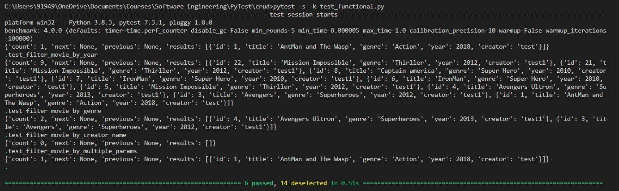
Functional Testing
Run Functional test
Result

Slide 23
Testing
01
02
03
04
Integration Testing
Functional Testing
Performance Testing
Unit Testing

Slide 24



Performance Testing
INTRODUCTION
Performance testing is a sort of testing that assesses how well a system performs and behaves under a certain workload or set of circumstances.
Performance testing often entails creating a large number of user requests, transactions, or other pertinent activities in order to simulate a realistic workload.

Slide 25

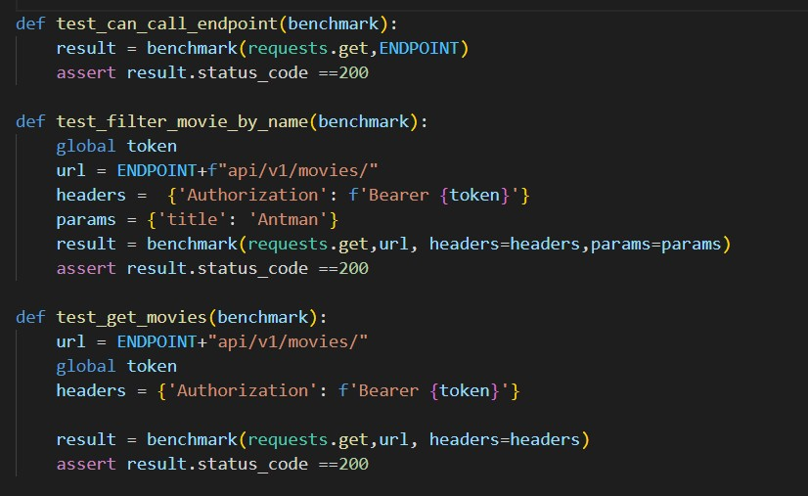
Performance Testing
Performance Test Script

Slide 26
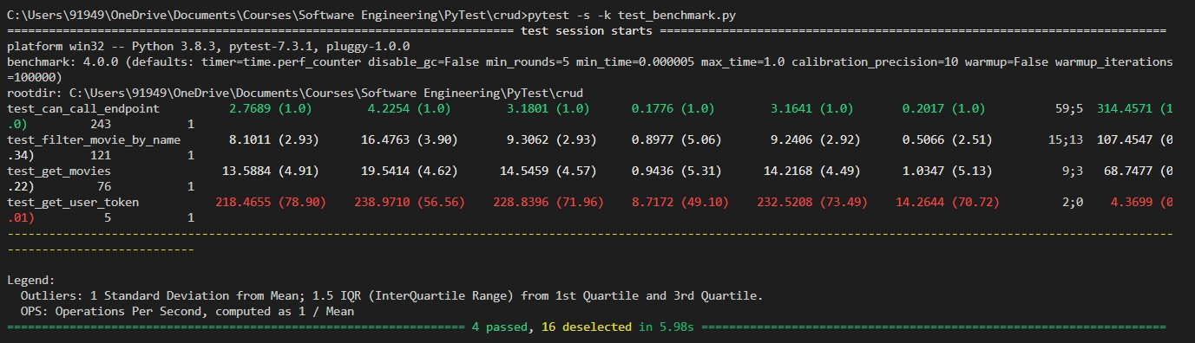
Performance Testing
Run test
Result

Slide 27
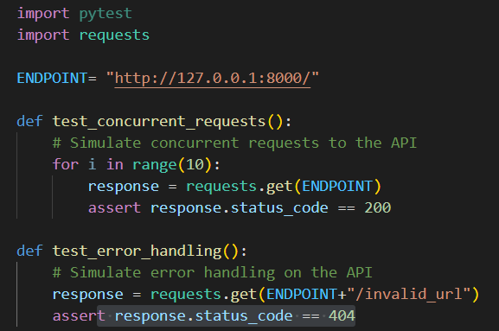
Operational Acceptance Testing
Test Script

Slide 28
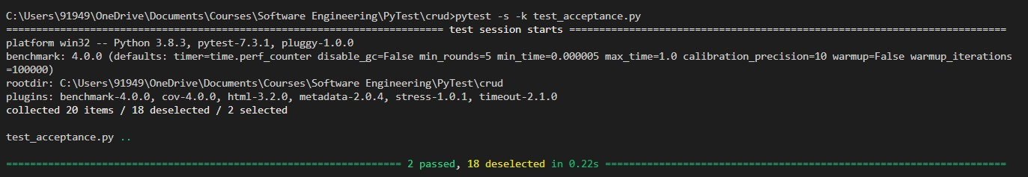
Operational Acceptance Testing
Run test
Result

Slide 29
Plugins
Adds More functionalities
Add custom command-line options, fixtures, hooks, and markers.
Pytest plugins can be installed using pip
4. 180+ plugins available
pytest-html : Generates HTML Report
pytest-cov : Test Coverage
pytest-benchmarks : Records Performance metrics
pytest-stress : Stress tests the Application
pytest-timeout : Set timeouts for individual tests

Slide 30
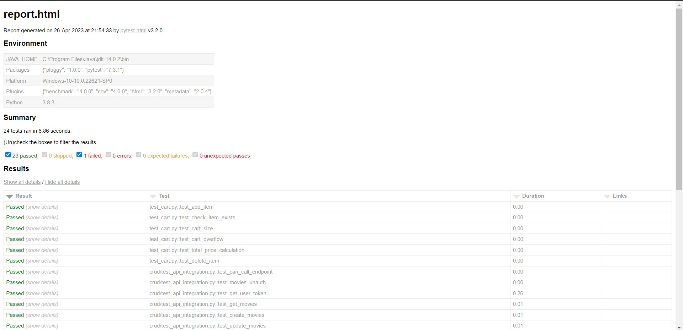
HTML Report

Slide 31
Conclusion
In conclusion, pytest is a powerful and popular testing framework for Python
that offers many benefits to developers. It provides an easy-to-use and intuitive syntax for writing tests, supports a wide range of test configurations and options, and is designed to be extensible through plugins and custom hooks.
Using pytest for testing can help developers save time and improve the quality of their code, by catching issues early on in the development process. Additionally, pytest is a community-driven project, with many contributors and supporters, which ensures that the framework is constantly improving and evolving.

Slide 32
Q&A?

Slide 33
THANK YOU

